Slide 1
The Airflow-Powered Motor
A Converter of Air Thermal Energy into Mechanical Energy
Prepared by Eudes Vera, Ph.D. – Kasgis Enterprise, Inc.

Slide 2
The Airflow – Powered Motor (APM) is an aerodynamic energy conversion system capable of extracting part of the thermal energy carried by an internally accelerated airflow to convert it into a significant amount of mechanical energy which can be used to generate electricity
Prepared by Eudes Vera, Ph.D. – Kasgis Enterprise, Inc.

Slide 3
The ratio of the mechanical power generated to the mechanical power applied to the system can be higher than the Betz limit of conventional wind turbines. Even ratios greater than 100% are quite possible
Prepared by Eudes Vera, Ph.D. – Kasgis Enterprise, Inc.

Slide 4
The Air Motor does not require storage of fuel and produces no contamination at all. Hence, Cost of fuel = 0
Prepared by Eudes Vera, Ph.D. – Kasgis Enterprise, Inc.

Slide 5
The most fundamental part of the airflow motor is the power generator element, that is, the Thermal Airfoil Turbine, consisting of two concentic cylinders and a number of airfoils placed over the surface of the innermost cylinder
Prepared by Eudes Vera, PhD – Kasgis Enterprise, Inc.

Slide 6
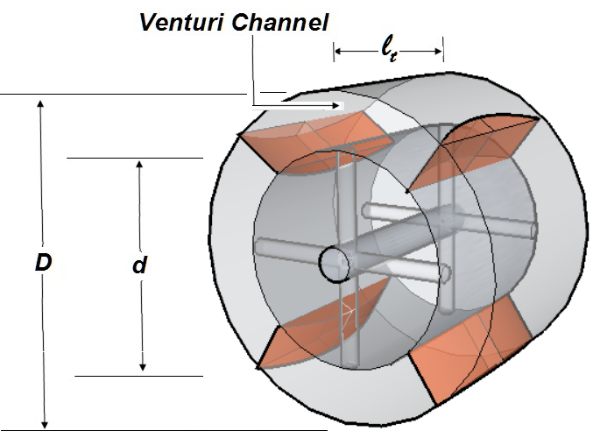
A thermal airfoil turbine with 4 airfoils
Prepared by Eudes Vera, PhD – Kasgis Enterprise, Inc.

Slide 7
A thermal airfoil turbine converts part of the internal energy of an airflow of velocity V_{φ} into rotational energy on its shaft without affecting significantly the airflow velocity. In other words, input and output airflow velocities are practically the same
Prepared by Eudes Vera, PhD – Kasgis Enterprise, Inc.

Slide 8
In contrast, in conventional wind turbines the blades decelerate significantly the incoming wind as they extract their rotational energy from the wind kinetic energy.
Prepared by Eudes Vera, PhD – Kasgis Enterprise, Inc.

Slide 9
Downwind of conventional wind turbines moves more slowly than upwind. The winds starts to slow down even before it reaches the blades
Prepared by Eudes Vera, PhD – Kasgis Enterprise, Inc.

Slide 10
In conventional wind turbines, it is not uncommon for the wind just before the turbine to lose about a third of its speed and downwind the wind speed can be reduced about two thirds
Prepared by Eudes Vera, PhD – Kasgis Enterprise, Inc.

Slide 11
Conventional HAWT wind turbines are convertors of the incoming wind kinetic energy into rotational energy of the blades. The output rotational power can never exceed 59.3% of the incoming kinetic power, according to Betz’s law
Prepared by Eudes Vera, PhD – Kasgis Enterprise, Inc.

Slide 12
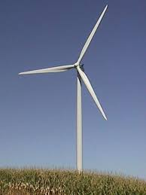
Prepared by Eudes Vera, PhD – Kasgis Enterprise, Inc.

Slide 13
Blades in conventional wind turbines act as obstacles to the wind whereas airfoils of thermal airfoil turbines look almost transparent to the incoming airflow so that the airflow velocity entering and outgoing the turbine remains practically the same
Prepared by Eudes Vera, PhD – Kasgis Enterprise, Inc.

Slide 14
Thermal Airfoil Turbines, on the other hand, are convertors of the internal (thermal) energy of the incoming airflow into rotational energy of the airfoils. The output rotational power can be much greater than 59.3% of the kinetic power of the incoming airflow.

Slide 15
Its operation is based on the aerodynamic phenomenon that takes places when an airflow with a velocity V_{φ} encounters the leading edge of an airfoil placed at a certain attack angle with the airflow direction
Prepared by Eudes Vera, PhD – Kasgis Enterprise, Inc.

Slide 16
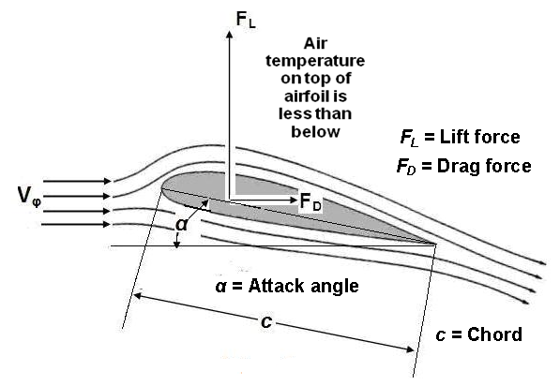
V
V
Fundamental Principle of Operation
Forces acting on an aero dynamical airfoil impacted by an airflow of velocity V_{φ}
Prepared by Eudes Vera, PhD – Kasgis Enterprise, Inc.

Slide 17
V
V
Fundamental Principle of Operation
It is well known that forces F_{L} and F_{D} are given by
F_{D} = C_{D} ρ V_{φ} ² A_{p} / 2
F_{L} = C_{L} ρ V_{φ} ² A_{p} / 2
Where
C_{D} = Airfoil Drag Coefficient; C_{L} = Airfoil Lift Coefficient;
A_{p} = Airfoil Area as seen by airflow; V_{φ} = Airflow Velocity;
ρ = Airflow density
Prepared by Eudes Vera, PhD – Kasgis Enterprise, Inc.

Slide 18
V
V
Fundamental Principle of Operation
By properly designing the airfoils and by choosing an adequate angle of attack α, it is possible to obtain that
C_{L} / C_{D} ˃˃ 1, so that F_{L} ˃˃ F_{D},
which ensures a high output power
Prepared by Eudes Vera, PhD – Kasgis Enterprise, Inc.

Slide 19
The Airflow-Powered Motor consists of a housing or empty chamber containing a converging (inlet )nozzle, a fan, a Venturi-like throat, a diverging (outlet) nozzle; and one or more thermal airfoil turbines that are placed within the Venturi-like throat
Prepared by Eudes Vera, PhD – Kasgis Enterprise, Inc.

Slide 20
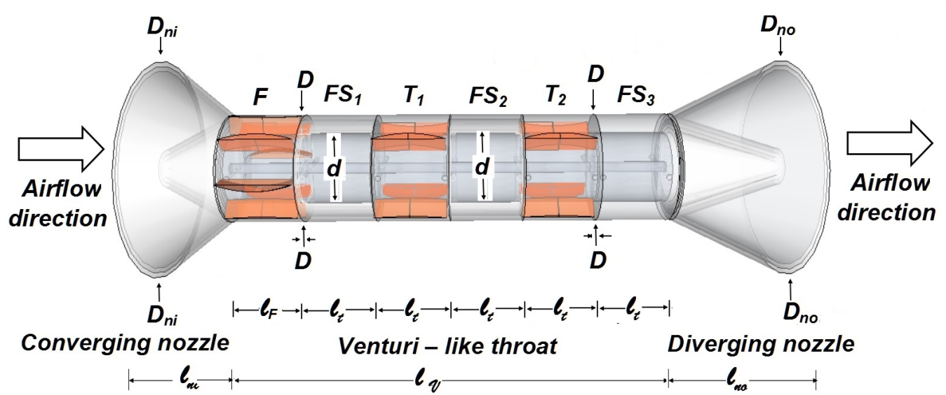
V
V
Schematic representation of the airflow motor showing the Empty Chamber , the fan F and two thermal airfoil turbines
Prepared by Eudes Vera, PhD – Kasgis Enterprise, Inc.

Slide 21
Notice that in the Airflow-Powered Motor the turbines are placed one behind the other because the airfoils do not reduce significantly the velocity of the flow. In contrast, conventional wind turbines always reduce the speed of the incoming wind and one turbine has to be tens of meters behind the other
Prepared by Eudes Vera, PhD – Kasgis Enterprise, Inc.

Slide 22
The Converging Nozzle serves to accelerate the incoming airflow. The Diverging Nozzle is the machine exhaust and serves to decelerate the outgoing airflow
Prepared by Eudes Vera, PhD – Kasgis Enterprise, Inc.

Slide 23
The Fan F is driven by an electric motor or a drill, and further accelerates the incoming airflow.
which is going to impact the thermal airfoil turbines located in the Venturi - like throat
Prepared by Eudes Vera, PhD – Kasgis Enterprise, Inc.

Slide 24
The turbines are the actual energy converters and are formed by a number of aerodynamic airfoils placed symmetrically around a revolving cylinder
Prepared by Eudes Vera, PhD – Kasgis Enterprise, Inc.

Slide 25
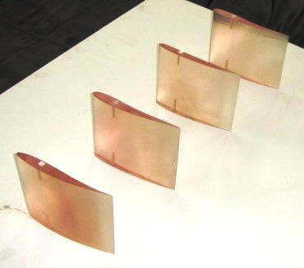
Aerodynamic airfoils
Prepared by Eudes Vera, PhD – Kasgis Enterprise, Inc.

Slide 26
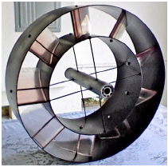
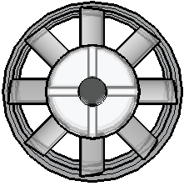
(a)
(b)
(a) A variety of an airfoil turbine having eight airfoils; b) Front view
Prepared by Eudes Vera, PhD – Kasgis Enterprise, Inc.

Slide 27
A Proof of Concept
Airflow Motor Prototype
Prepared by Eudes Vera, PhD – Kasgis Enterprise, Inc.

Slide 28
A POC Airflow Motor Prototype consisting of two identical turbines uses the following geometric parameters: D = 50 cm; d = 32 cm; b = 8 cm; c = 26.5 cm
Prepared by Eudes Vera, PhD – Kasgis Enterprise, Inc.

Slide 29
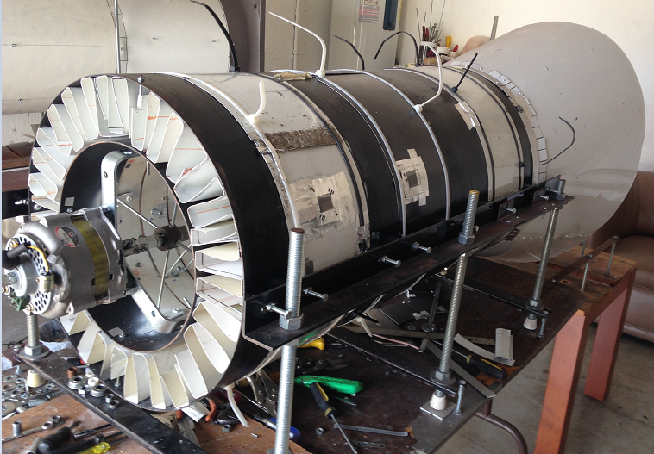
Airflow Motor, including two turbines, Converging nozzle, Fan, and Alternator
to generate electric current (Diverging nozzle is not included)
Prepared by Eudes Vera, PhD – Kasgis Enterprise, Inc.

Slide 30
The starter or blower is simply a fan which provides an airflow in the Venturi – like passage at a certain speed V_{ϕ.} It is well known that the mechanical power generated by the airfoils is proportional to V_{ϕ}³
Prepared by Eudes Vera, PhD – Kasgis Enterprise, Inc.

Slide 31
So useful power can be increased simply by increasing V_{ϕ}. Useful power depends on the number of aerodynamic airfoils as well
Prepared by Eudes Vera, PhD – Kasgis Enterprise, Inc.

Slide 32
Additionally, the useful power provided by one generator (turbine) can be duplicated if two generators are employed, or tripled if three generators are used, and so on
Prepared by Eudes Vera, PhD – Kasgis Enterprise, Inc.

Slide 33
Aerodynamic airfoils
Prepared by Eudes Vera, PhD – Kasgis Enterprise, Inc.

Slide 34
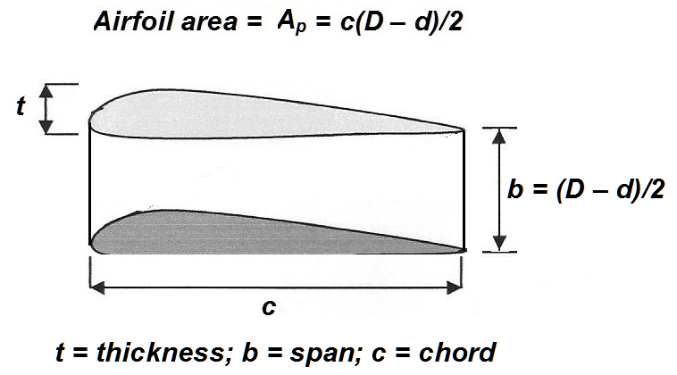
Perspective view of an aerodynamic airfoil
Prepared by Eudes Vera, PhD – Kasgis Enterprise, Inc.

Slide 35
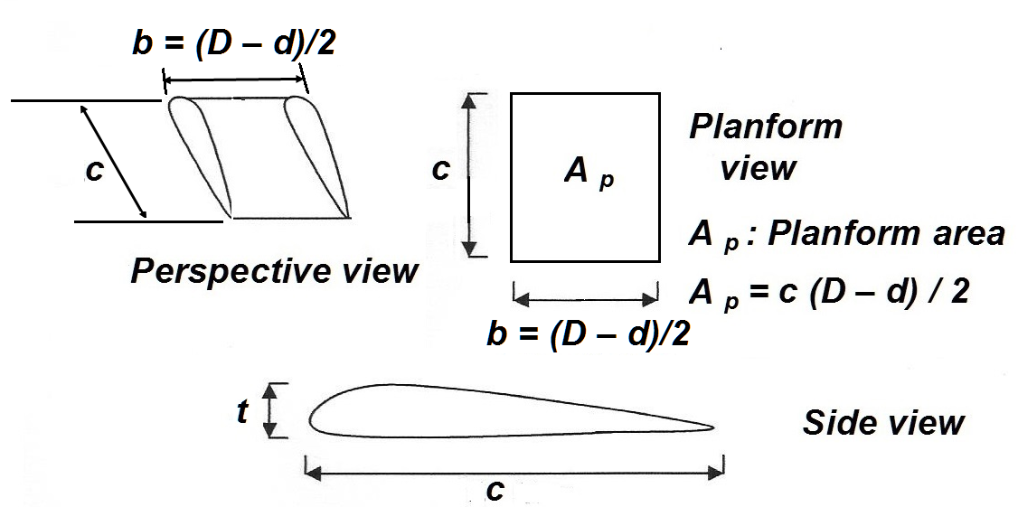
Three views and some geometrical parameters of an airfoil
Prepared by Eudes Vera, PhD – Kasgis Enterprise, Inc.

Slide 36
If the static attack angle is chosen to be about 45°, the approaching airfoil sees the airfoils at an apparent attack angle close to 0°, where the ratio C_{L} / C_{D} is much greater than 1. This means that airfoils are quasi – transparent to the airflow
Prepared by Eudes Vera, PhD – Kasgis Enterprise, Inc.

Slide 37
The drag power and the generated power for the Airfow-powered motor are given respectively by
P_{D} = (1/2) ρ N_{a} N_{s} C_{D} A_{p} cos α V_{φ}³, W P_{G} = (1/2) ρ N_{a} N _{s} C_{L} A_{p} sin α V_{φ}³, W
Where ρ is the air density, N_{a} is the number of airfoils, N_{s} is the number of identical stages in the turbine placed in the Venturi – like section, α is the attack angle, A_{p} is the airfoil planform area; V_{φ} is the airflow velocity; and C_{D} and C_{L} are respectively the drag and the lift coefficients
Prepared by Eudes Vera, PhD – Kasgis Enterprise, Inc.

Slide 38
The efficiency of a thermal airfoil turbine is defined as
ղ_{t} = (P_{G} / P_{D})
And the airflow motor efficiency is defined as
ղ_{AM} = (P_{G} / P _{i}) (100)
Where P_{i} is the power supplied by the fan to the airflow
By proper design of the airfoils and turbine parameters, the airflow – powered motor can achieve an efficiency much greater than 1, that is, the APM can be a self sustaining device
Prepared by Eudes Vera, PhD – Kasgis Enterprise, Inc.

Slide 39
There is a range of fan’s angular velocities at which the output power from a generator is less than the power applied to the fan
Prepared by Eudes Vera, PhD – Kasgis Enterprise, Inc.

Slide 40
However, as the angular velocity of the fan is increased, there appears a range of angular velocities where the output power is greater than the applied power, i.e., a power gain takes place
Prepared by Eudes Vera, PhD – Kasgis Enterprise, Inc.

Slide 41
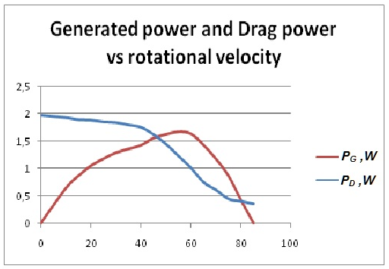
Generated power and Drag power for a low-power thermal airfoil turbine as a function of the turbine rotational velocity in rpm
Prepared by Eudes Vera, PhD – Kasgis Enterprise, Inc.

Slide 42
The proof of concept airflow-powered motor prototype has two thermal airfoil turbines each having 4 airfoils, and is capable of generating 625 W of output power when operating at a fan rotational speed of 1,555 rpm while consuming only 591 W.
If the airflow velocity were to be duplicated by duplicating the fan rotational speed, this prototype can generate up to 5 kW, which is sufficient to power an average household
Prepared by Eudes Vera, PhD – Kasgis Enterprise, Inc.

Slide 43
If the fan is removed from the airflow motor, the latter can be used as a very efficient wind turbine. As a wind turbine if the input wind power is 591 W, the prototype built could generate 625 W, which means that this wind turbine would have an efficiency of 105.75%. No existing conventional wind turbines can achieve such a high efficiency
Prepared by Eudes Vera, PhD – Kasgis Enterprise, Inc.

Slide 44
However, keep in mind that the thermal airfoil turbine is not a conventional wind turbine
Prepared by Eudes Vera, PhD – Kasgis Enterprise, Inc.

Slide 45
The TAT converts airflow internal energy in rotational energy without affecting much the airflow velocity, whereas the HAWT converts the kinetic energy of the wind into rotational energy but affecting significantly the wind velocity
TAT vs. HAWT
Prepared by Eudes Vera, PhD – Kasgis Enterprise, Inc.

Slide 46
TAT’s airfoils are almost transparent to the airflow whereas HAWT’s blades are rather an obstacle to the wind flow
TAT vs. HAWT
Prepared by Eudes Vera, PhD – Kasgis Enterprise, Inc.

Slide 47
Large and constant static angle of attack of TAT airfoils (typically 45° - 50°)
Small static angle of attack of HAWT blades
TAT vs. HAWT
Prepared by Eudes Vera, PhD – Kasgis Enterprise, Inc.

Slide 48
TAT airfoil geometric parameters: Taper ratio λ = 1; Sweep angle Ʌ = 0°
HAWT blade geometric parameter: Taper ratio λ << 1; Sweep angle Ʌ > 0°
TAT vs. HAWT
Prepared by Eudes Vera, PhD – Kasgis Enterprise, Inc.

Slide 49
TAT predominant dimension: horizontal (Airfoil chord c is much larger than airfoil span b)
HAWT predominant dimension: vertical (Blade span b is much larger than blade chord c)
TAT vs. HAWT
Prepared by Eudes Vera, PhD – Kasgis Enterprise, Inc.

Slide 50
The Airflow-Powered Motor requires very little maintenance (mostly periodical lubrication of bearing and cleaning of airfoils and cylinders
Prepared by Eudes Vera, PhD – Kasgis Enterprise, Inc.

Slide 51
Assuming the initial cost per generated kilowatt for the Airflow-Powered Motor as 30 USD, the cost of the APM kilowatt - hour can be estimated in 0.068 cents, the lowest of current renewable energy technologies
Prepared by Eudes Vera, PhD – Kasgis Enterprise, Inc.

Slide 52
Thank you!
Prepared by Eudes Vera, PhD – Kasgis Enterprise, Inc.

